Slide 1
Saudi Arabia Real Estate (AQAR) mujtaba Alnashaba
DSB3

Slide 2
Introduction
This project is an examination of real estate listings from four Saudi cities.
Four cities are listed in the dataset namely, Riyadh, Jeddah, Dammam, and Khobar.
The variables to be analyzed include property prices, location, size, and property features.
Python was utilized to analyze, visualize and clean the dataset.

Slide 3
Problem Statement
Price varies based on the city and district.
Similar properties can have different prices.
Duration of rent is not explicitly mentioned.
Duplicates and outliers may influence the results.
It complicates a fair price comparison.

Slide 4
Objectives & Dataset
Dataset: 3,718 entries with 24 columns.
Compare prices of cities and districts.
Analyze size, number of rooms, age, pool, and frontyard.
Determine the correlation between the variables and high estimated annual prices.

Slide 5
Data Cleaning
Deleted 2 out of range size values.
Deleted 1 sale entry identified.
Final dataset for analysis: 3,715 listings.
Missing descriptions were not deleted.
Duplicate rows were not deleted due to lack of unique property identifier.

Slide 6
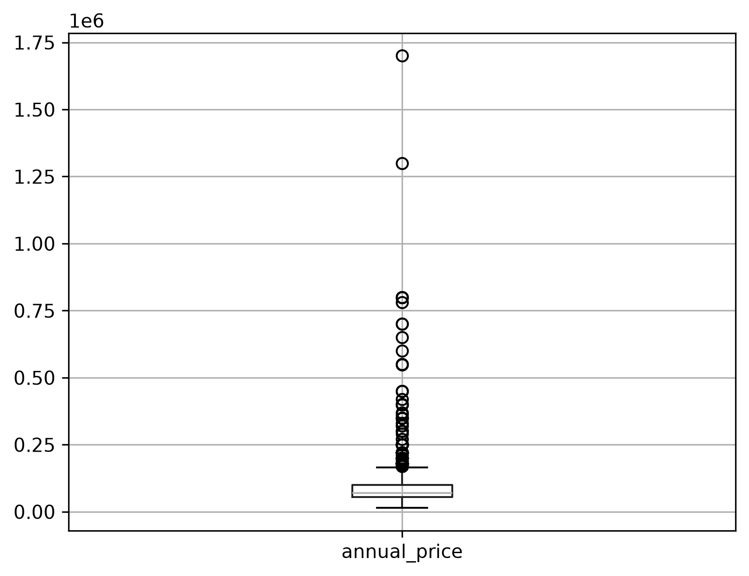
Outliers & Price Distribution
IQR was used to check for outliers.
Outliers were evaluated not deleted automatically.
Median estimated annual price is SAR 70,000.
The distribution of price is right skewed.

Slide 7
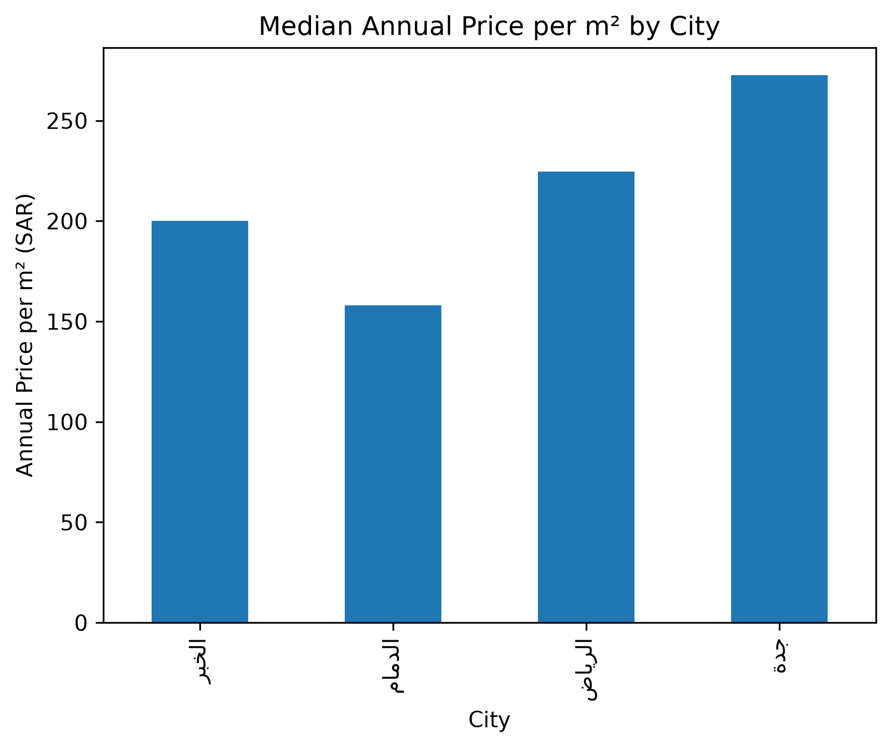
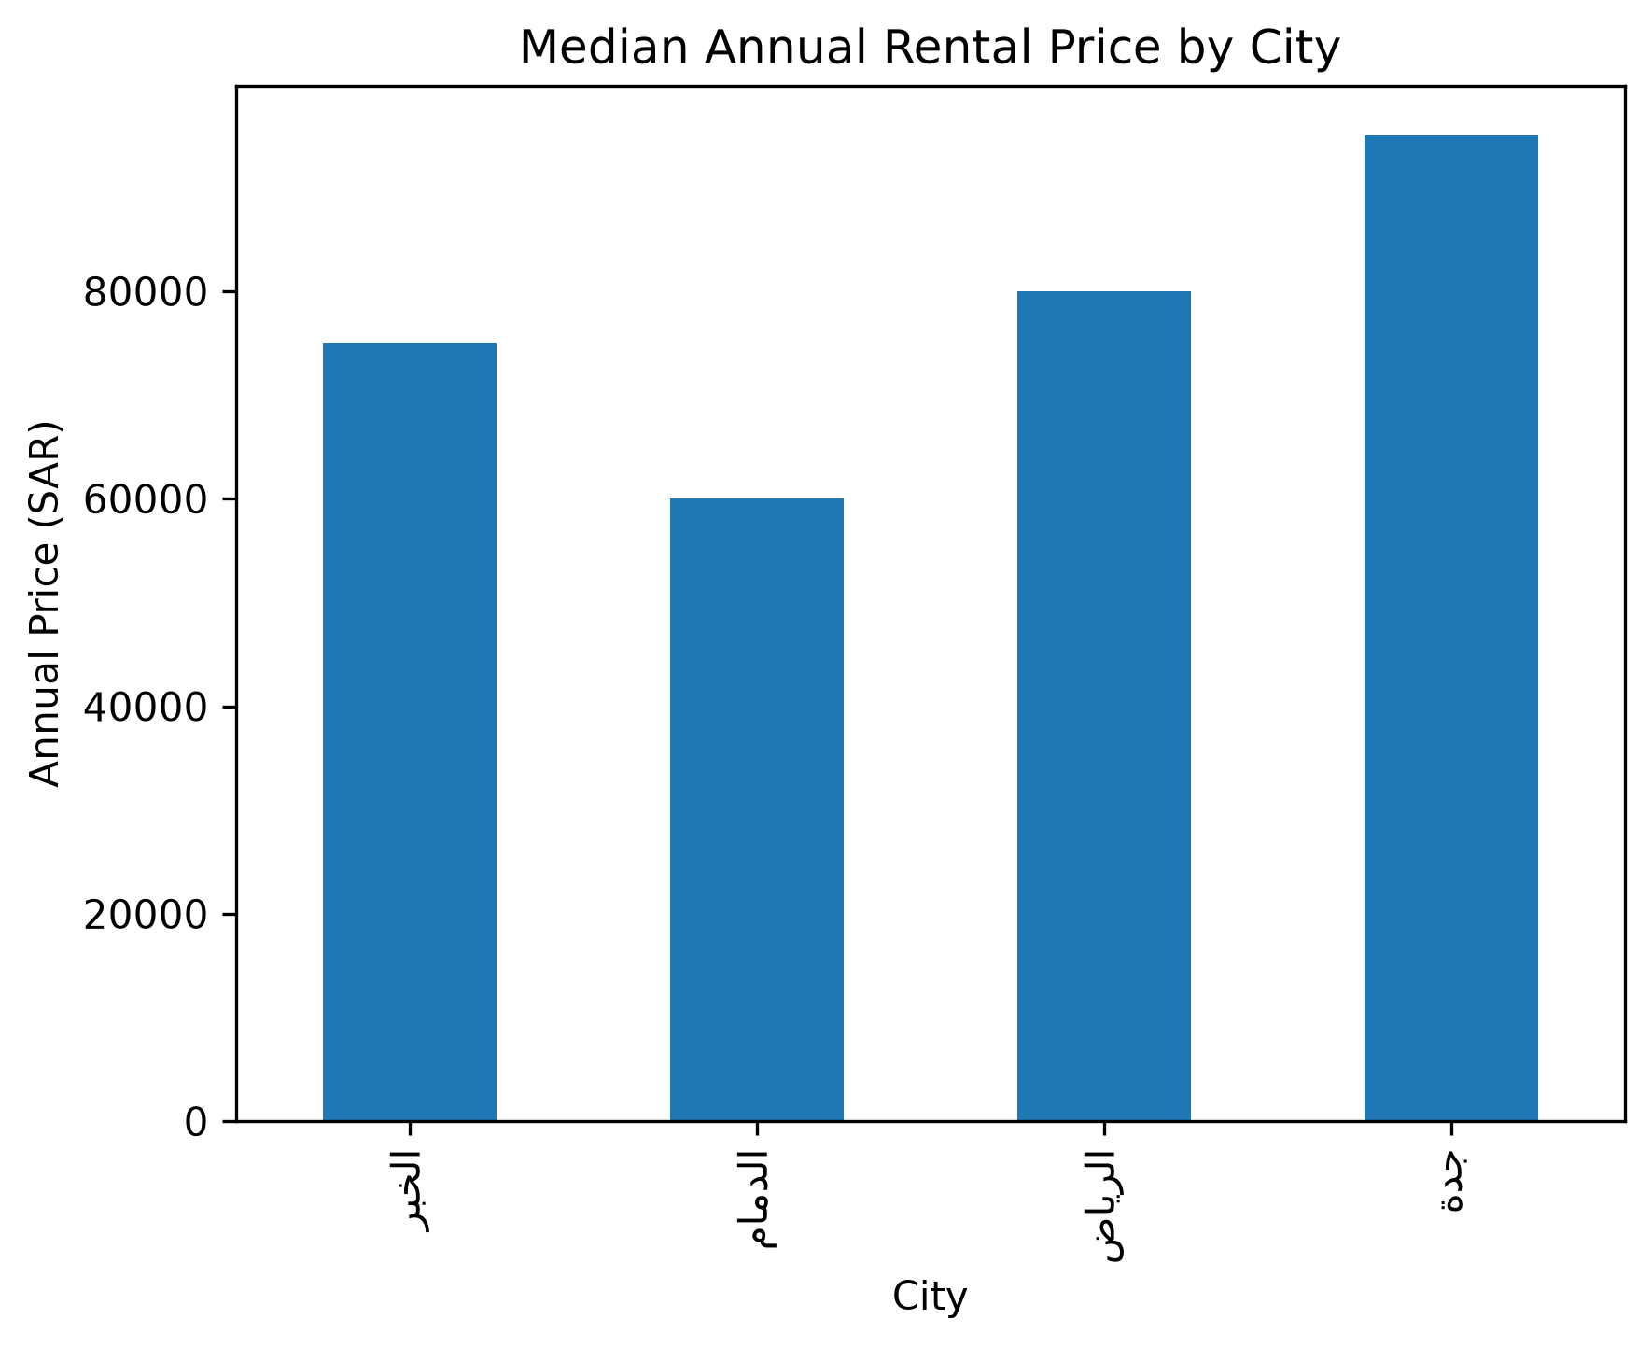
City Price Comparison
.

Slide 8
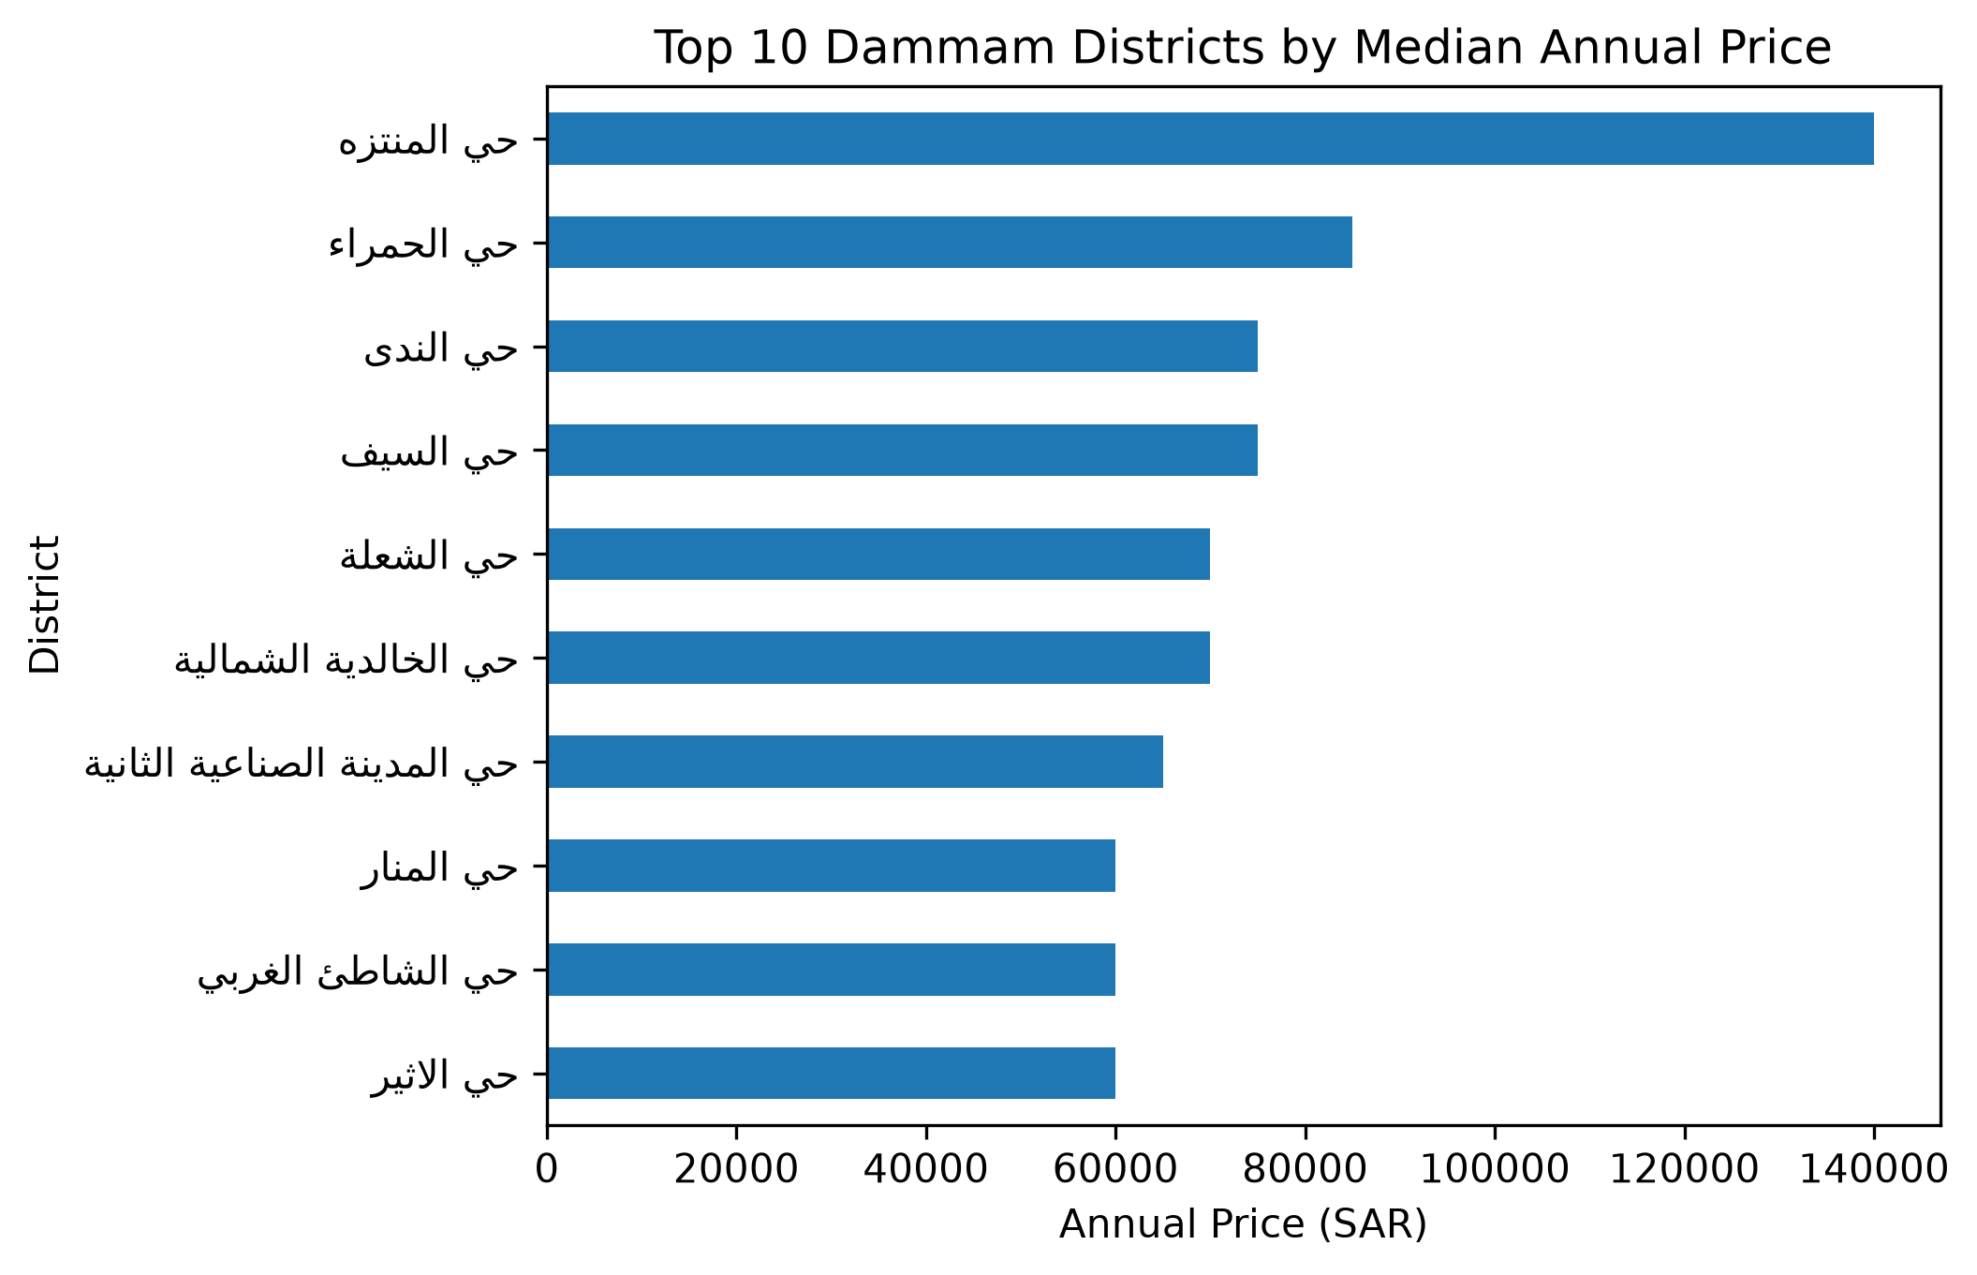
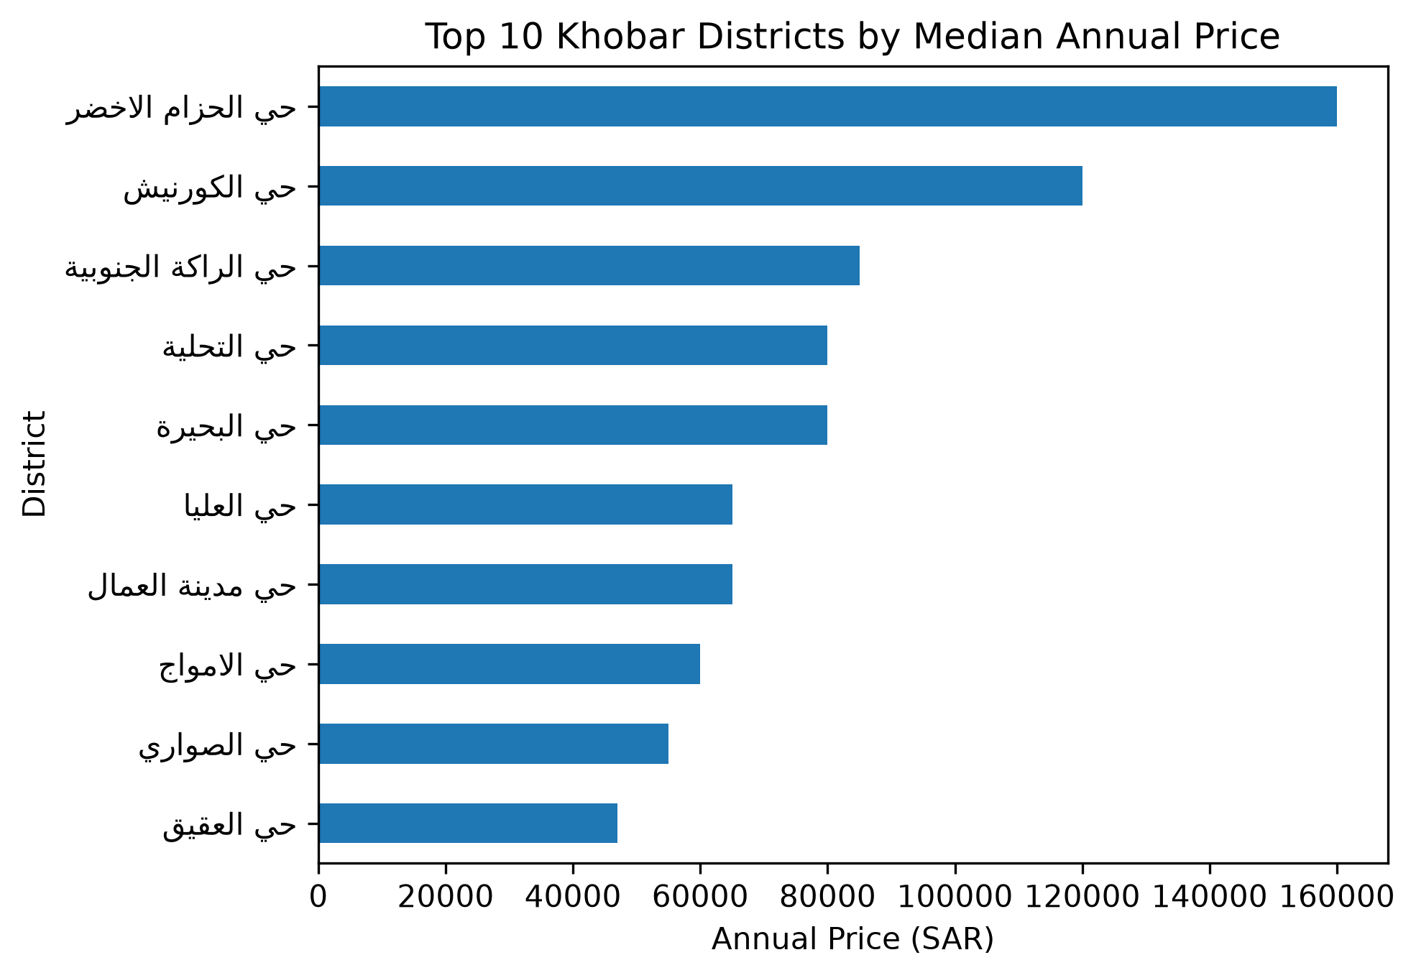
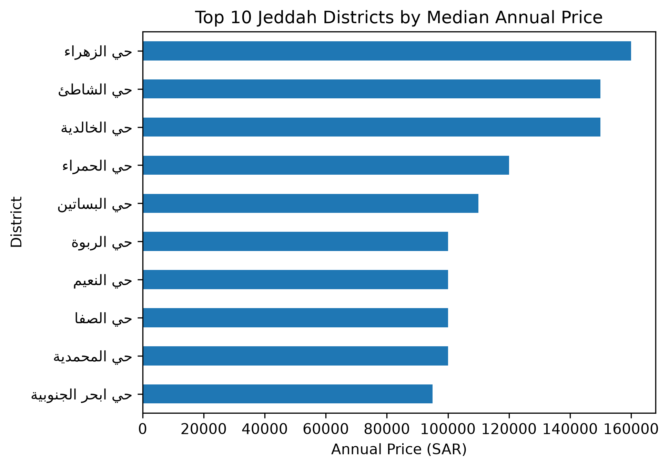
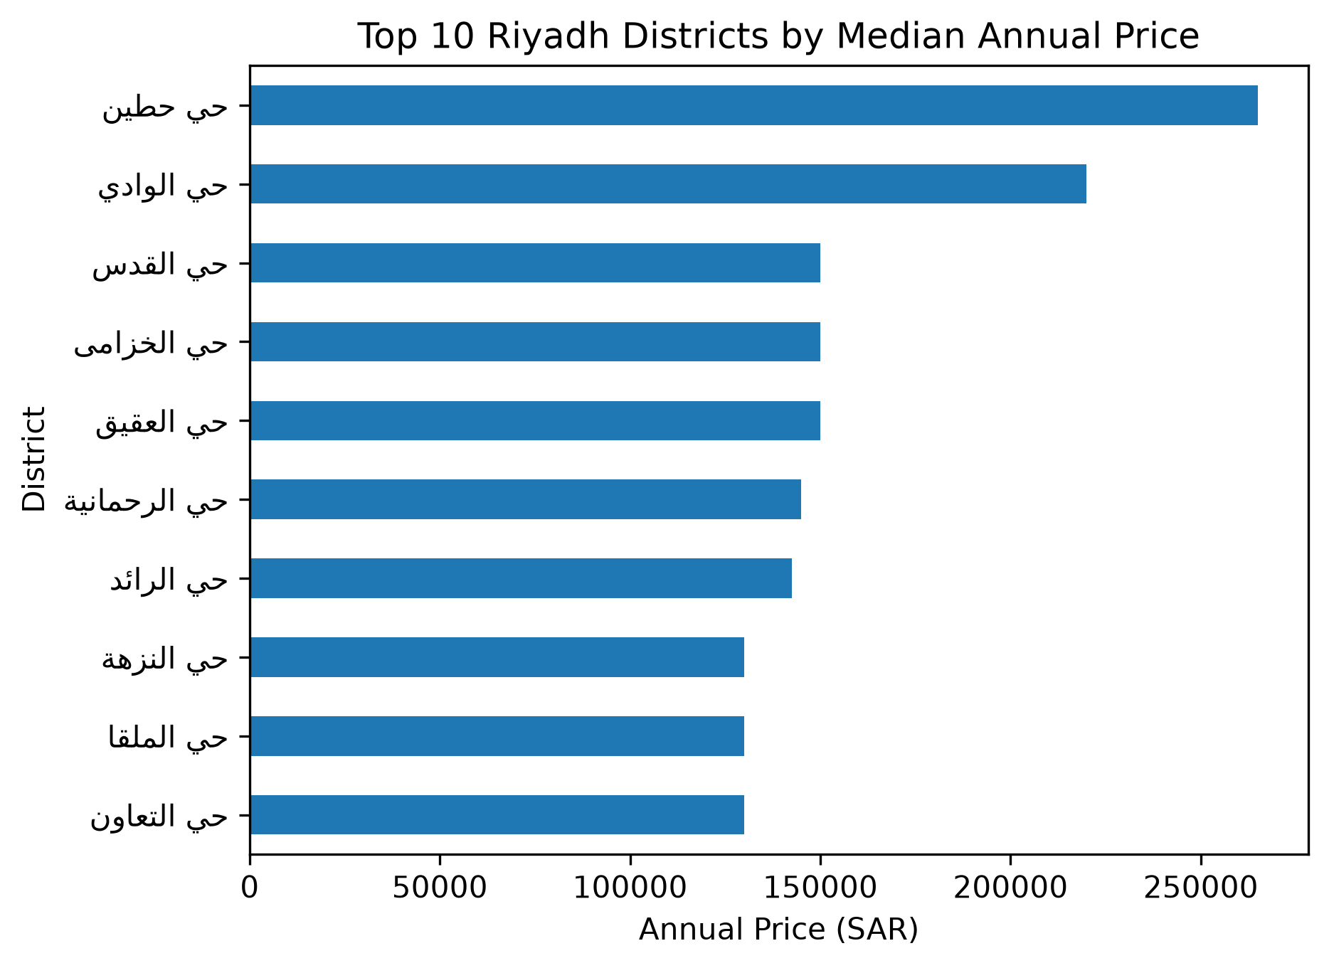
District Analysis

Slide 9
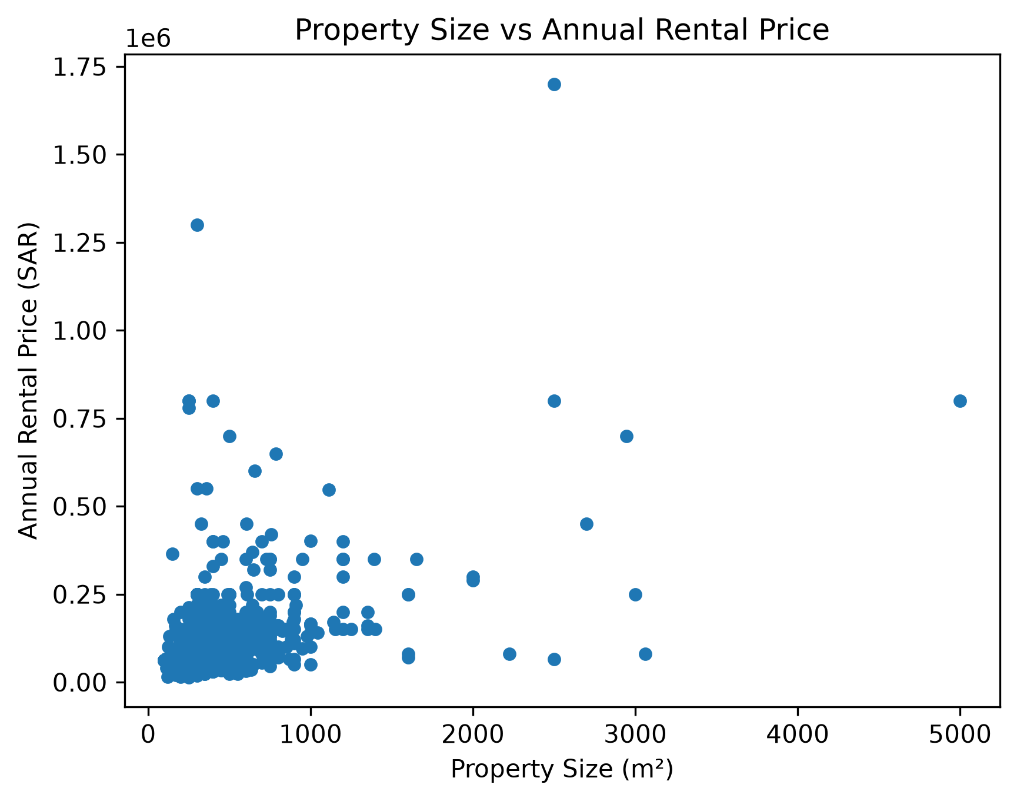
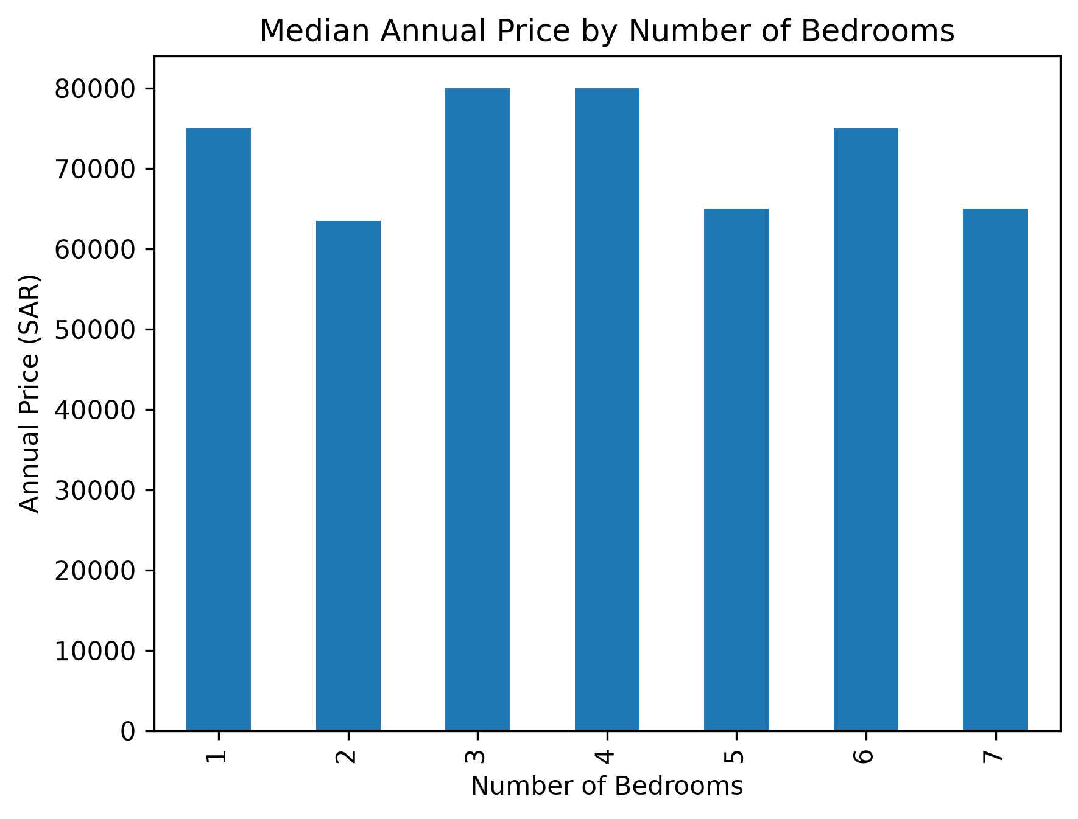
Size & Bedrooms
There was a positive relationship between size and price: r = 0.42
Larger properties generally have higher prices, but not necessarily.
Bedrooms were not increasing in the number of price.

Slide 10
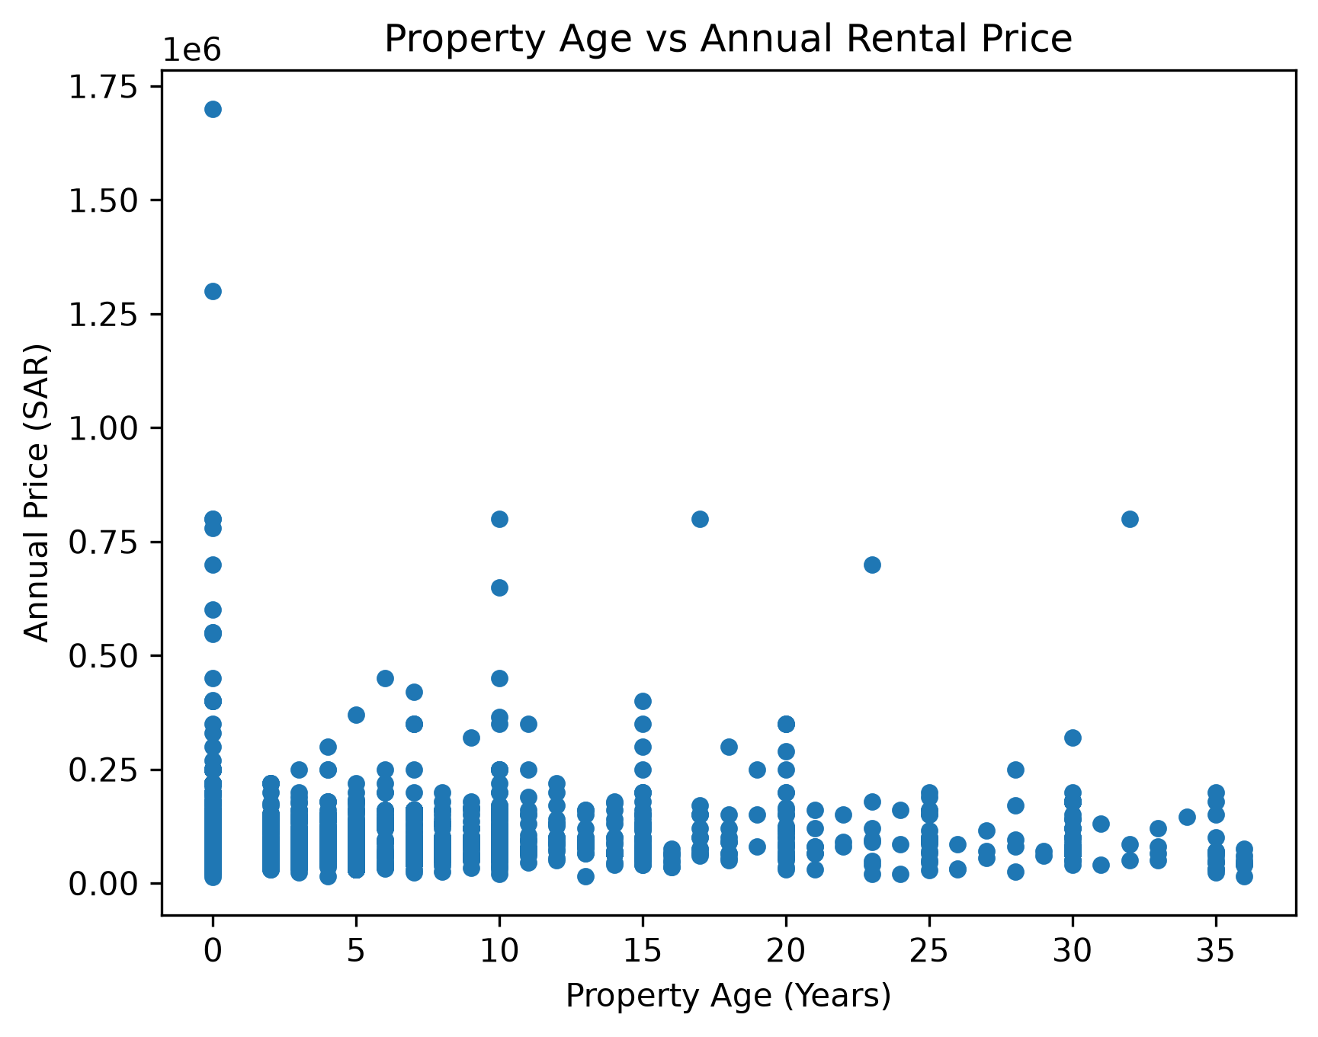
Property Age
Property age had a weak correlation with price: r = 0.15.
Age is not a determining feature of rental price.
There are other factors that matter more such as city, district, and features.

Slide 11
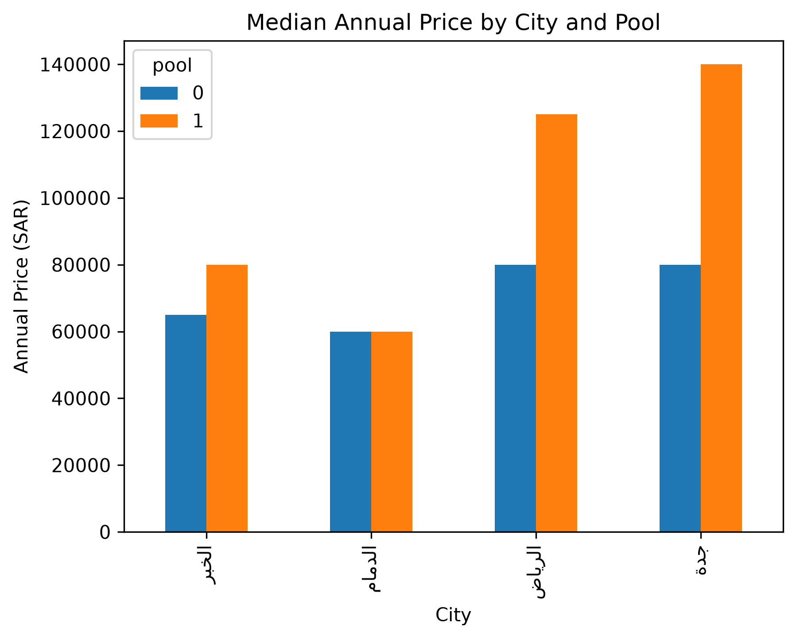
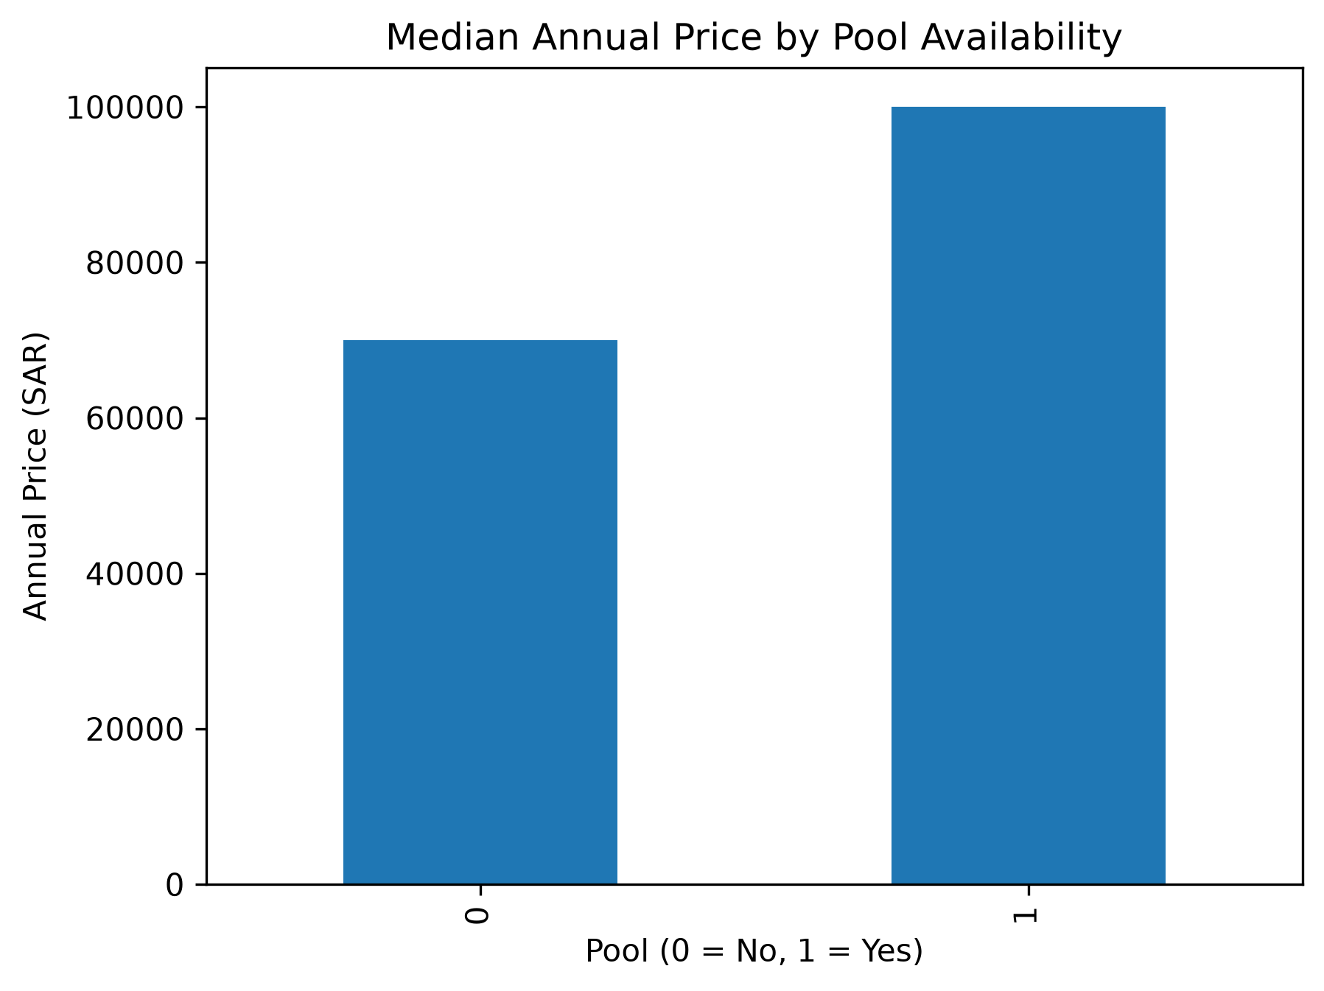
Swimming Pool
Properties that have pools had a higher median price.
With pool: SAR 100,000.
Without pool: SAR 70,000.
Price difference varied from one city to another.

Slide 12
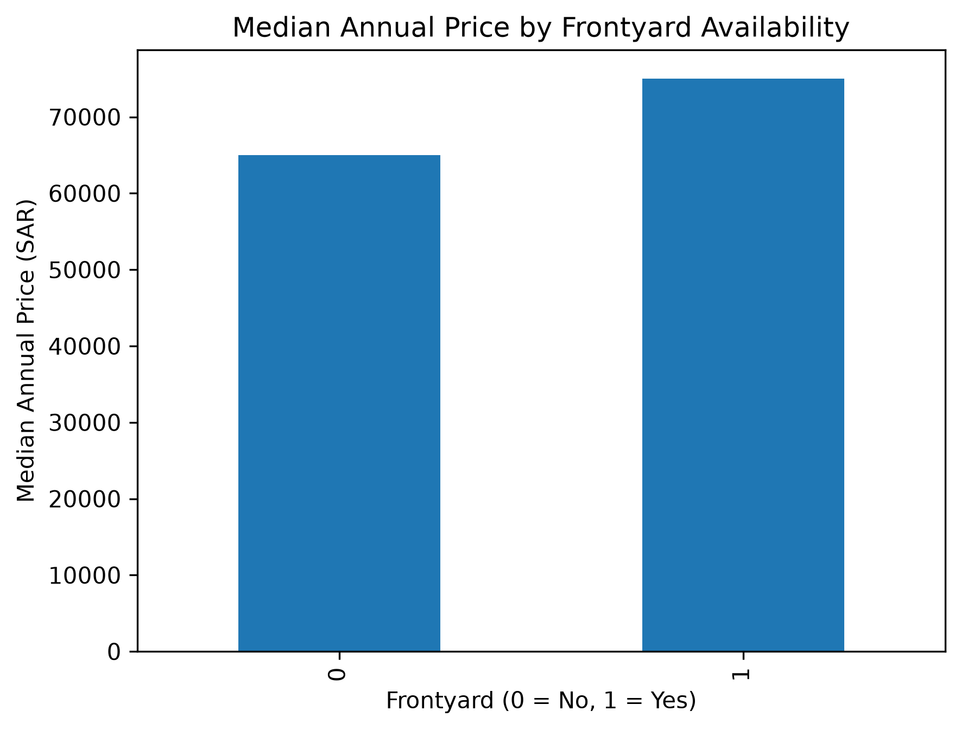
Frontyard
Properties that had a frontyard had higher median price..
With frontyard: SAR 75,000.
Without frontyard: SAR 65,000.
However, this pattern varied for each city.

Slide 13
Jeddah had the highest median price and price per m².
Size showed moderate connection with price.
Bedrooms and age were poor predictors of the price.
Pool and frontyard showed high connection with prices.
Location is still a significant factor.
Key Findings

Slide 14
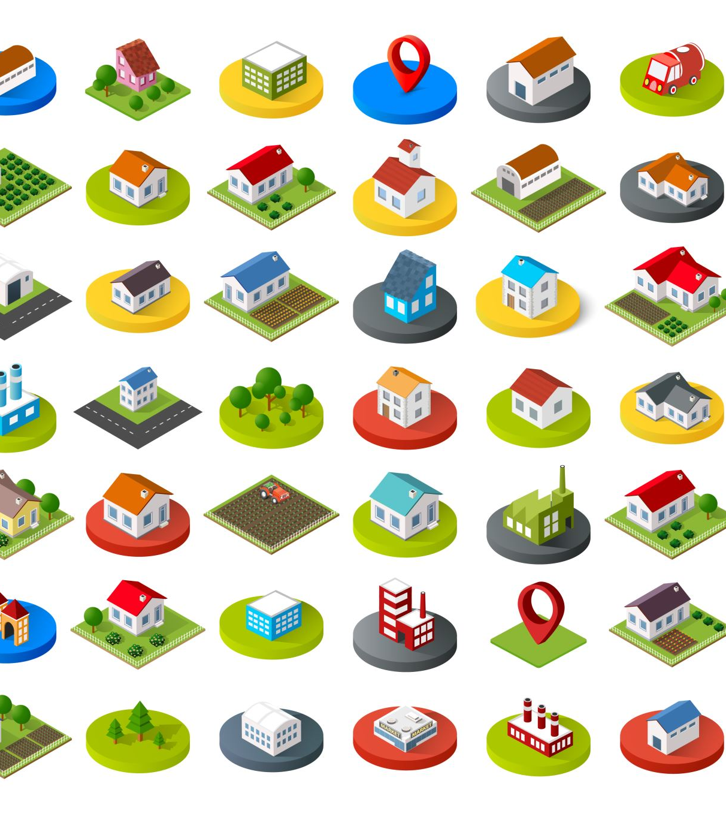
Recommendations & Conclusion
Compare the properties in the same city and district.
Median is used instead of mean due to outliers.
Check the duration of rental before final comparison.
Include property IDs to deal with duplication issue.
Findings are descriptive in nature.

